Slide 1

KEN4256 Projects

Slide 2
Project
Individual project to demonstrate your creativity and technical virtuosity
(60% of final grade; 10% project proposal, 50% written project report)

Slide 3
Types of Projects
Building knowledge graphs. choose 2 or more publicly available and open datasets about any topic that you are interested in, that are not already available in RDF. Convert them to RDF, link them to standardized ontologies and/or construct a FAIR ontology, assess KG quality, and demonstrate its utility by answering research-worthy competency questions.
Mining a knowledge graph: choose one or more existing knowledge graphs (preferably of large size with millions of entities) and apply techniques such as semantic data integration, link prediction, and/or advanced reasoning to derive new information from the graph which is not explicitly present. Ensure there is a proper evaluation of the approach. Try to find insights that are counterintuitive, surprising and add to the body of human knowledge.
Build and mine a knowledge graph. This project requires a new graph to be constructed in support of KG-specific data mining. The project is focused on this end to end exploration, and therefore may not necessarily have to address every expectation with respect to a study devoted to either building a high quality KG, or mining one or more KGs.

Slide 4
Project Proposal
The project proposal must be at most 2 pages (excluding references).
Significance: (What is the problem, and why is it an important problem? Who is impacted by the problem? What is the cost of not solving the problem? What opportunities arise should the problem be addressed?)
Related work (Are there others who tried to do this or something similar before? If not, describe how previous work is different from what you propose and what gap yours will fill in the body of scientific knowledge.)
Goal and specific objectives (What is the overarching goal of the project? What specific objectives will be pursued in the project? Briefly describe how these objectives will be addressed. Indicate how these objectives are relevant to the course learning objectives)
Anticipated results (What do you expect the main outputs of your project to be in terms of new knowledge or insights, new technology or capabilities, challenges addressed, and importance to others)
Approach (How you intend to answer your research questions. What data and technologies are you going to use? Why are they the most suitable to answer your research questions or solve your problem? What elements of the project are risky, and how will you mitigate this risk e.g. what is your plan B? Include an overview diagram to communicate your project architecture, components, and plans)
Milestones & deliverables (Checkpoints and deliverables in the project that can be used to measure progress. These can be in the form of modules for a software package; components or sections of a Knowledge Graph if you are constructing one; subset of a full set of questions that will be answered by certain checkpoints in the project etc.)
References: A section containing proper references for inline citations. Use a citation manager like Endnote, Zotero, Mendeley, or Paperpile to insert and automatically format citations and references.

Slide 5
Project Report (6 pages)
The project report must be at most 6 pages (excluding references).
The report must contain the following major sections:
Project Title, date, student name, and student number.
Abstract: A brief summary of the project and findings.
Introduction: An introduction to the project including the problem description and goal and specific objectives.
Related Work.
Methodology.
Results: A description of the results supported by tables and figures. Include references to result materials (e.g. specific files in the project zip file)
Discussion: Your interpretation of the results. In what way does the results support or dispute your hypothesis or shed light on your research questions? What challenges were faced and how were they addressed? What didn’t work, and why? What new insights could you find that add to the body of scientific knowledge? What questions are left unsolved? what way could your or another person extend the work in a future study? In what way did this project help fulfill the course learning objectives?
Conclusions: Briefly summarize the approach, findings, and their significance.
References.

Slide 6
Evaluation Rubric
Project proposal is out of maximum of 6 points, and includes Significance, Methodology, and Quality of Writing
Project report is out of a maximum of 10 points, and includes Significance, Methodology, Quality of Results, Quality of Discussion, Quality of Writing
Significance (2 points)
The significance of the problem is not described nor supported with literary references [0]
The significance of the problem is reasonably well communicated, with some literary references and evidence of its importance [1]
The significance of the problem is convincingly communicated with ample references and substantive evidence of importance [2].
Methodology - Feasibility and Innovation (2 points)
serious issues with methodology, either too simple or too complex, unclear approach and/or deemed infeasible [0]
feasible with some concerns that can be addressed, of moderate ambition and/or complexity [1]
ambitious, innovative, well planned, risk mitigation included, clear overview of the approach [2]

Slide 7
Rubric
Quality of Writing (2 points)
poorly written, a struggle to understand the work [0]
well written, good flow that free of grammatical and spelling mistakes [1]
superbly written, inspiring to read [2]
Quality of Results (2 points)
the results are poorly described, if at all [0]
the results are well described and/or illustrated, but there are several questions regarding the work performed and results obtained [1]
the results are clear and very well presented [2]
Quality of Discussion (2 points)
The discussion does not properly describe the nature and significance of the results [0]
The discussion summarizes findings, and offers a reasonable but faulty analysis of their significance [1]
The discussion summarizes findings, correctly interprets these findings, places them in the context of related work, and offers several new avenues for follow up work [2]

Slide 8
Proposal Criteria, elaborated
Relevance
To what extent is the work and methods described relevant to the project as a whole and the course objectives?
Significance
What is the problem being addressed in the project? How important is this problem? Consider: Who is affected by the problem? How much money do people spend addressing the problem / what is the cost of not solving the problem? What are the benefits / outcomes of solving the problem?
Approach
Is the approach appropriate for the problem? Is the approach sufficiently clear and detailed to enable their reproduction by a peer? Is there a useful diagram to illustrate the approach? Are the limitations of the approach clearly articulated? Is the amount of work involved trivial (using an existing tool) or more challenging (developing a new pipeline and/or method)?
Feasibility. Is the approach feasible? Does it appear overly complicated or is it relatively straightforward? Does it comprise of the data needed to answer the research question? If the project is only on building a KG,does it consist of several independent resources that have been brought together to answer the research question? Is there a plan to assess the quality of the KG? To what extent does the KG address the FAIR principles? Does it use shared vocabularies / ontologies?
Quality of writing
Clear: avoids unnecessary detail, is free of mistakes in spelling and grammar
Simple: uses direct language and avoids vague or complicated sentences. Technical terms are properly defined and used only when they are necessary for accuracy
Organized: text is divided into appropriate sections with clear headings
Objective: statements and ideas are supported by appropriate evidence. References to scientific literature are provided where necessary
Length: 2 pages (we should provide a template)

Slide 10
Significance
What is the problem, and why is it an important problem?
Who is impacted by the problem?
What is the cost of not solving the problem?
What opportunities arise should the problem be addressed?

Slide 11
The following includes excerpts from a student proposal, with their permission.

Slide 12
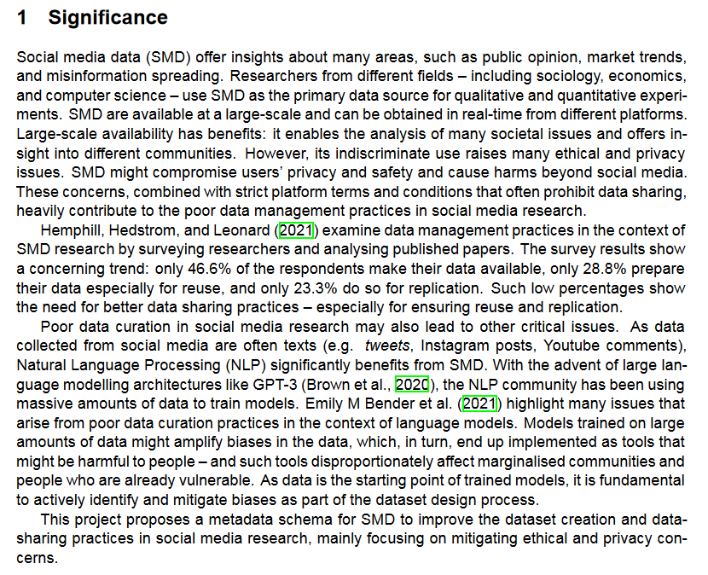
General introduction

Slide 13
all is not rosy...

Slide 14
deeper exploration of the problem, with references to the literature

Slide 15
Rationale for the proposal
Introduction to proposal

Slide 16
Related Work
Are there others who tried to do this or something similar before?
If not, describe how previous work is different from what you propose and what gap yours will fill in the body of scientific knowledge.

Slide 17
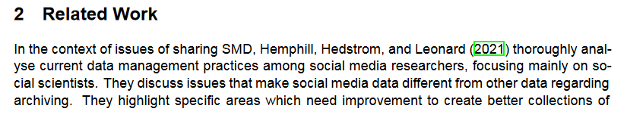
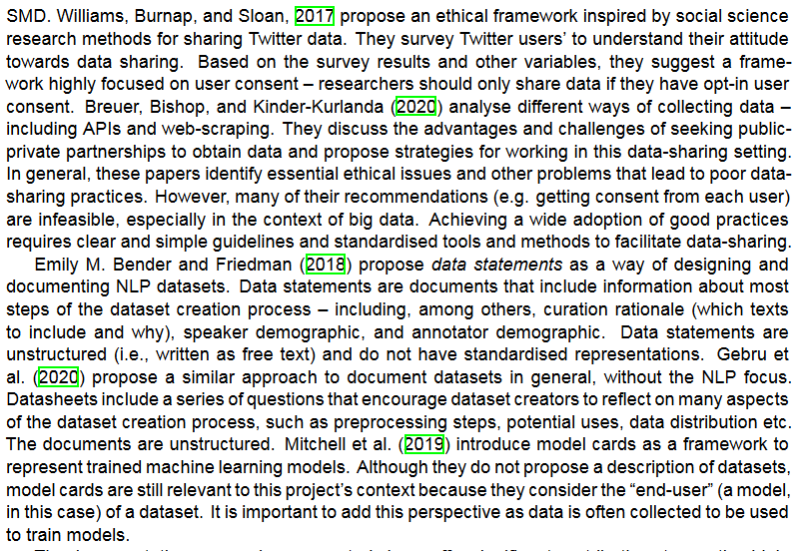
addressing elements in the introduction, with inline citations

Slide 18
further elaboration of the findings

Slide 19
introducing innovative elements in the field, which will help to contrast what is being proposed

Slide 20

identify shortcomings, and position the proposed work

Slide 21
Goal and specific objectives
What is the overarching goal of the project?
What specific objectives will be pursued in the project?
Briefly describe how these objectives will be addressed.
Indicate how these objectives are relevant to the course learning objectives

Slide 22
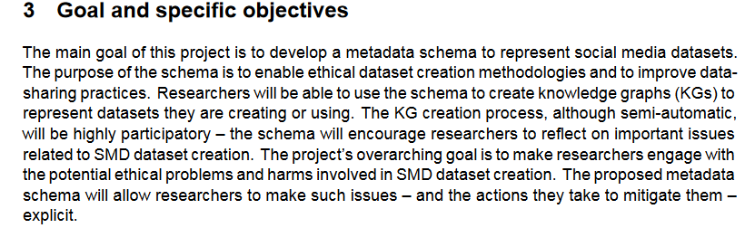
what will be done

Slide 23
why it is needed, given what was argued before

Slide 24
who will benefit?
how will they benefit?

Slide 25
anticipated impacts

Slide 26
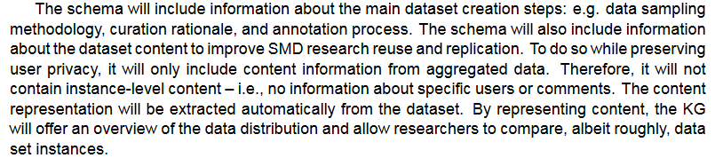
the main idea

Slide 27
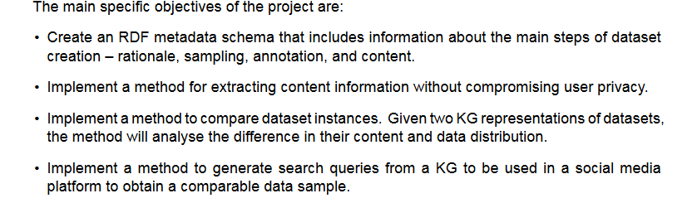
tangible objectives

Slide 28
Methodology
How you intend to answer your research questions.
What technologies are you going to use?
Why are they the most suitable to answer your research questions or solve your problem?
What elements of the project are risky, and how will you mitigate this risk e.g. what is your plan B?
Include an overview diagram to communicate your project architecture, components, and plans)

Slide 29
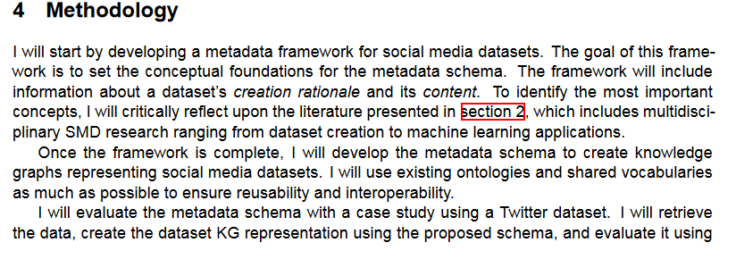
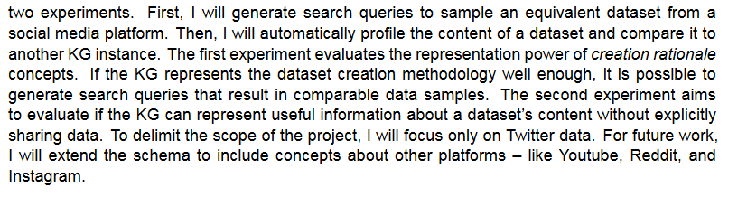
component & how

Slide 30
component & considerations

Slide 31
evaluation & approach

Slide 32
risk mitigation

Slide 33
MIlestones and Deliverables
Checkpoints and deliverables in the project that can be used to measure progress. These can be in the form of modules for a software package; components or sections of a Knowledge Graph if you are constructing one; subset of a full set of questions that will be answered by certain checkpoints in the project etc.

Slide 34
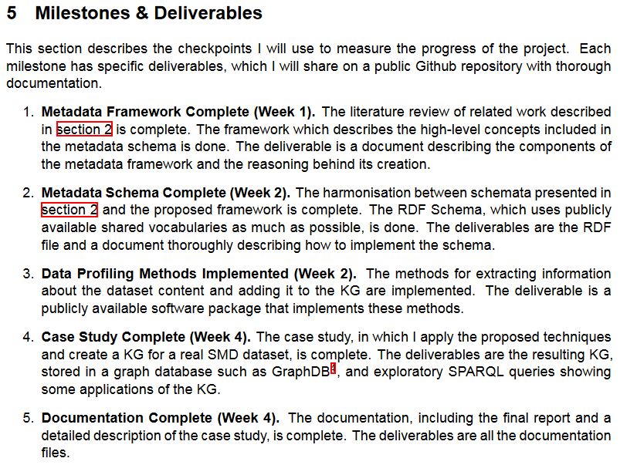
component,
timeline,
and deliverable

Slide 35
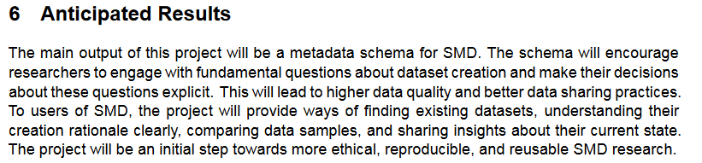
Anticipated Results
What do you expect the main outputs of your project to be in terms of new knowledge or insights, new technology or capabilities, challenges addressed, and importance to others

Slide 36

References
A section containing proper references for inline citations. Use a citation manager like Endnote, Mendeley, or Paperpile to insert and automatically format citations and references.

